Slide 1
INSTRUCTIONS
Drag a headshot over the white circle, and scale it to make sure it covers the entire circle
Right click on the photo and select “Order” and then “Send Backward”
Once finished, click “File” in the upper left, then “Download” and “JPEG Image” to save your graphic!
Don’t forget to tag us with our official hashtags, #ChooseToChallenge and #IWD2021
Notes:
INSTRUCTIONS
Drag a headshot over the white circle, making sure it covers the entire circle
Right click on the photo and select “Order” and then “Send Backward”
Once finished, click “File” “Download” and “JPEG Image” to save your graphic!
Don’t forget to tag us with our official hashtags, #ChooseToChallenge and #IWD2021

Slide 2
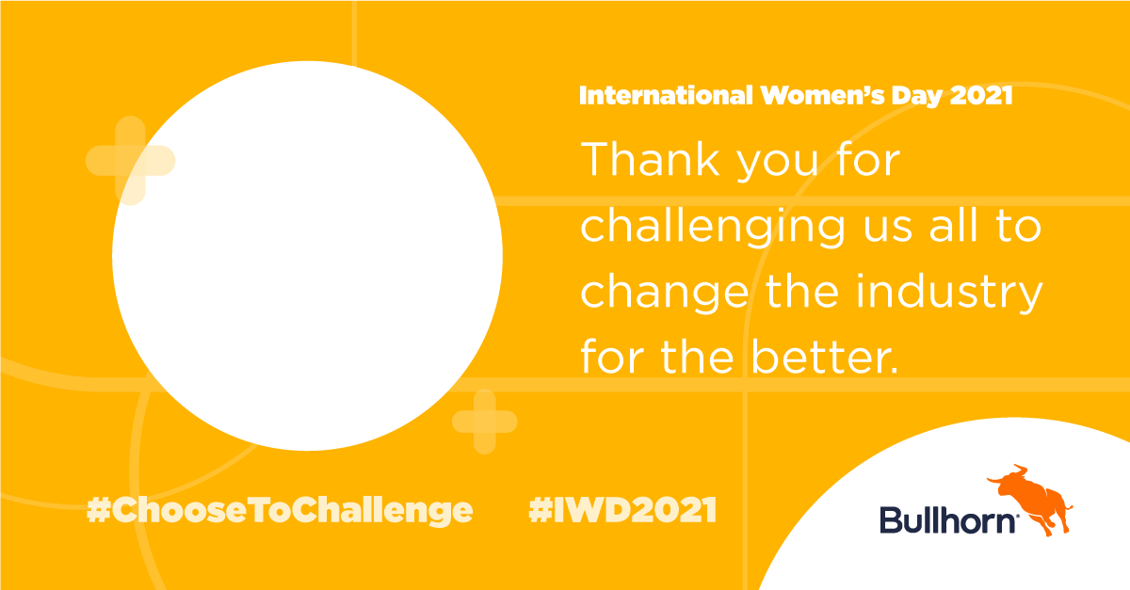
Notes:
INSTRUCTIONS
Drag a headshot over the white circle, making sure it covers the entire circle
Right click on the photo and select “Order” and then “Send Backward”
Once finished, click “File” “Download” and “JPEG Image” to save your graphic!
Don’t forget to tag us with our official hashtags, #ChooseToChallenge and #IWD2021

